Slide 1

Intrusion Detection in a Network using Machine Learning and Neural Network Approaches
This presentation will explore the use of machine learning and neural networks for intrusion detection in networks. We'll delve into the challenges posed by evolving cyber threats and how these cutting-edge approaches offer a powerful solution.
Presented by
Shivam Dangi-21BCE5883
Mucheli Akshay Reddy-21BCE5910
Om Prakash-21BCE1950
L Sai Pranav Reddy-21BCE1762

Slide 2
Motivation: Evolving Cyber Threats and the Need for Sophisticated Intrusion Detection
Evolving Threats
Sophisticated Intrusion Detection
Cybercriminals are constantly evolving their tactics, employing increasingly complex and sophisticated attacks.
Modern intrusion detection systems require advanced capabilities to identify and respond to these ever-changing threats.

Slide 3

Overview of Intrusion Detection Systems (IDS)
Role of IDS
Types of IDS
Intrusion detection systems act as security guards, monitoring network traffic and identifying potential malicious activities.
IDS can be categorized as network-based, host-based, or hybrid, depending on their monitoring location and scope.
Key Components
IDS typically include sensors to collect data, analysis engines to detect threats, and response mechanisms to mitigate risks.

Slide 4

Traditional Approaches to Intrusion Detection
Signature-Based Detection
Anomaly Detection
These methods identify deviations from normal network behavior, potentially indicating malicious activities.
Traditional IDS rely on predefined patterns or signatures of known attacks to identify threats.
Rule-Based Systems
These systems use predefined rules to identify malicious patterns, based on specific network traffic characteristics.

Slide 5




Limitations of Traditional IDS
Limited Effectiveness
Traditional IDS struggle to detect zero-day attacks and other novel threats that lack predefined signatures.
High False Positive Rates
Anomaly detection methods can generate a significant number of false alarms, overwhelming security teams and hindering real threat identification.
Inability to Adapt
Rule-based systems require manual updates to account for new attack methods, making them slow and reactive.

Slide 6

Machine Learning for Intrusion Detection
1
Data Collection
Machine learning algorithms require large datasets of network traffic, labeled with attack types and normal activities.
2
Model Training
Algorithms are trained on the data to identify patterns and anomalies, learning to distinguish between malicious and benign traffic.
3
Real-Time Detection
The trained model can then be deployed to analyze live network traffic, identifying potential threats and triggering alerts.

Slide 7




Neural Network Techniques for Intrusion Detection
Deep Learning Models
Neural networks, especially deep learning models, have shown promising results in intrusion detection.
Feature Extraction
Neural networks excel at automatically extracting relevant features from raw network data.
Adaptive Learning
These models can adapt to new threats and evolve their detection capabilities without manual intervention.

Slide 8




Dataset and Feature Engineering
1
Dataset Selection
Feature Engineering
2
Selecting the right dataset and engineering relevant features are crucial for effective model performance.
3
Data Preprocessing
4
Model Training

Slide 9
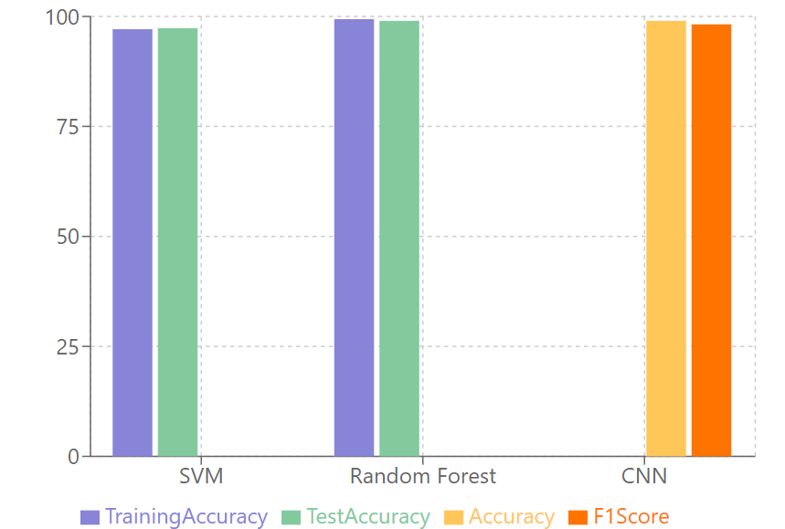
Comparison of ML and Neural Network Models
99%
Accuracy
Neural networks generally achieve higher accuracy compared to traditional machine learning models.
100%
Efficiency
Machine learning models offer faster inference times and require less computational power.
0.9%
False Positives
Neural networks are more prone to generating false positives, requiring careful tuning and validation.

Slide 10

Conclusion and Future Directions
Machine learning and neural networks offer powerful tools for enhancing intrusion detection capabilities. Future research should focus on addressing challenges like false positives and adapting to rapidly evolving threats. We must continuously evolve our security solutions to stay ahead of the ever-changing cyber landscape.

